Slide 1





PRESENTATION 2026
Sales & Business Data Cleaning and Visualization
Mentor Name
Student Name
Student Email
Umamaheshwari
Amruta Anant Nadkar
nadkaramruta42@gmail.com

Slide 2

Outline
Abstract of the Project
Problem Statement
Proposed Solution
System Architecture
Live Demo of the Project
Embedded Video of Project
Conclusion
Future Scope

Slide 3
Abstract
This project focuses on analyzing Flipkart sales data using Microsoft Excel and Power BI. The objective is to clean, organize, and transform raw data into meaningful insights for better business decision-making. Excel was used for data cleaning, handling missing values, and removing duplicates, while Power BI was used to create interactive dashboards and visualizations. The project highlights key insights such as sales trends, top-performing products, and regional performance. Overall, it demonstrates how data analytics tools can convert raw data into actionable business intelligence.

Slide 4

Problem Statement
Organizations often deal with large volumes of sales data that contain errors such as missing values, duplicates, and inconsistent formats, making accurate analysis difficult. This problem is significant because poor data quality leads to incorrect insights and weak business decisions. Business analysts, managers, and decision-makers are directly affected by unreliable data. Traditional methods lack efficient visualization and real-time analysis capabilities. This project focuses on cleaning and analyzing sales data using Excel and Power BI, within the scope of data preprocessing and dashboard creation, without involving advanced predictive modeling.

Slide 5

Proposed Solution
The proposed solution involves cleaning and transforming raw sales data using Microsoft Excel by removing duplicates, handling missing values, and standardizing formats. After preprocessing, the cleaned dataset is imported into Power BI to build interactive dashboards and visualizations such as KPI cards, bar charts, and trend analysis. This approach enables accurate data analysis and clear representation of insights. Compared to traditional methods, it provides faster processing, better visualization, and improved decision-making support.

Slide 6
System Architecture
Data Input / Source
Processing / Analysis
The dataset was downloaded from Kaggle and provided in Excel/CSV format containing Flipkart sales data, which was uploaded for analysis.
Data was cleaned and transformed in Microsoft Excel by removing duplicates and handling missing values, then analyzed in Power BI using charts and measures.
AI / Tool Integration
Output / Dashboard
Excel was used for preprocessing, Power BI for visualization, and AI tools like ChatGPT were used to generate insights and reports.
The final output is an interactive Power BI dashboard with visualizations such as KPI cards, bar charts, pie charts, and sales trend analysis.

Slide 7
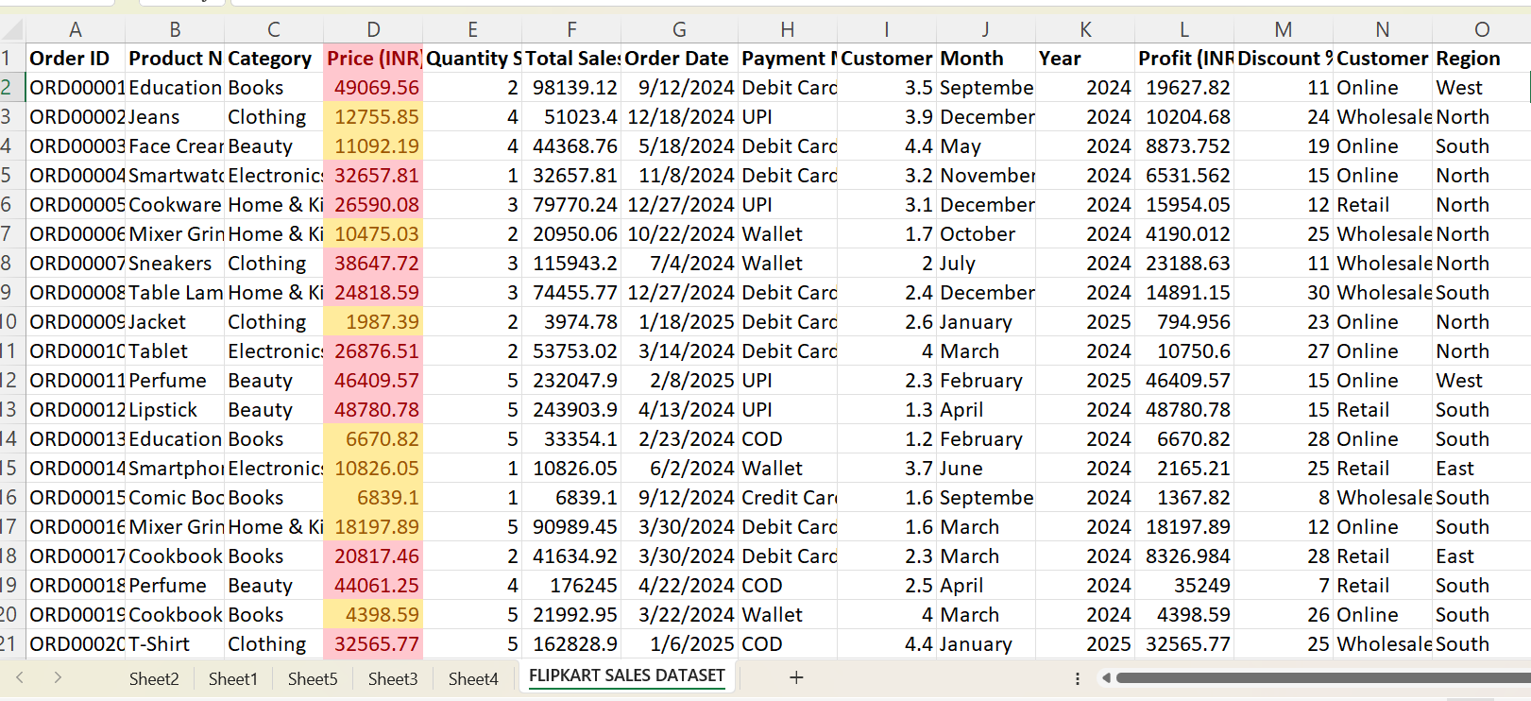
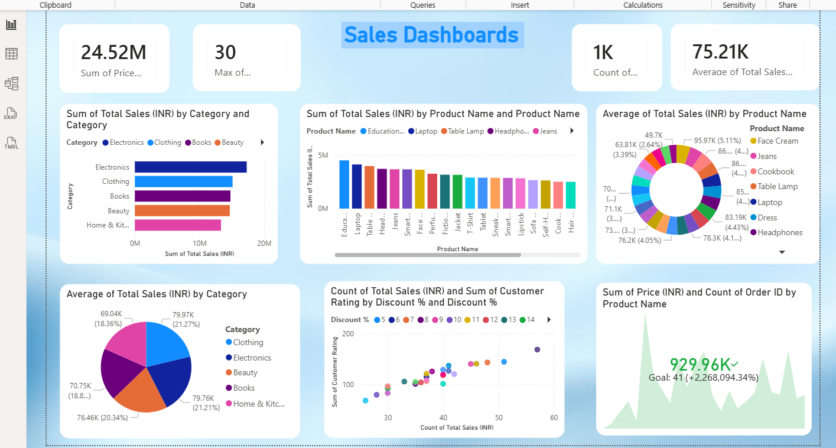
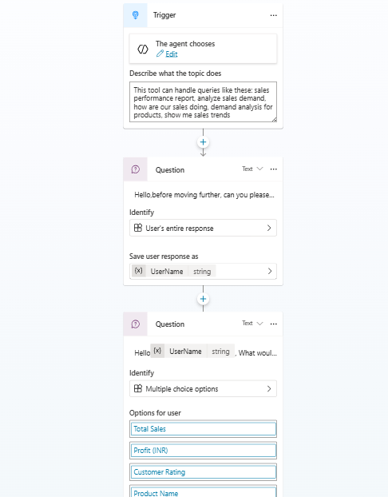
Live Demo of Project
Here's the list of some demo screenshots / features of the project:
Demo 1
Demo 2
Demo 3

Slide 8
Video of Project Demo
[https://your-project-demo-link.com]
▶
[Insert your project demo video.
You can embed a video your live project.]

Slide 9

Conclusion
This project successfully demonstrated how raw sales data from Kaggle can be transformed into meaningful insights using Microsoft Excel and Power BI. Through effective data cleaning, preprocessing, and visualization, key patterns such as sales trends, top-performing products, and regional performance were identified. All project objectives were achieved by converting unstructured data into an interactive and insightful dashboard. The integration of Excel and Power BI improved accuracy, efficiency, and decision-making capabilities. Overall, this project highlights the importance of data analytics tools in generating valuable business intelligence.
CONCLUSION

Slide 10

Future Scope
This project can be further enhanced by integrating real-time data sources such as APIs to provide live sales updates and dynamic dashboards. Advanced analytics techniques like predictive modeling and forecasting can be applied to identify future sales trends. The dashboard can be expanded using tools like Power BI Service for cloud sharing and collaboration. Additionally, automation using AI tools like Copilot can improve efficiency in report generation. The project can also be scaled to handle larger datasets and applied to different business domains for broader impact.

Slide 11
Thank You
AICW Fellowship | Student Project Presentation 2026
LinkedIn | Edunet Foundation

